Slide 1
Vocabulary for WHEN

Slide 2
cart / kɑːt / noun
1 a vehicle with no roof that is pulled by a horse and used for carrying heavy things
2 American English a large wire basket on wheels that you use in a supermarket SYN trolley British English

Slide 3
lounge / laʊndʒ / noun a waiting room at an airport :
- the departure lounge

Slide 4
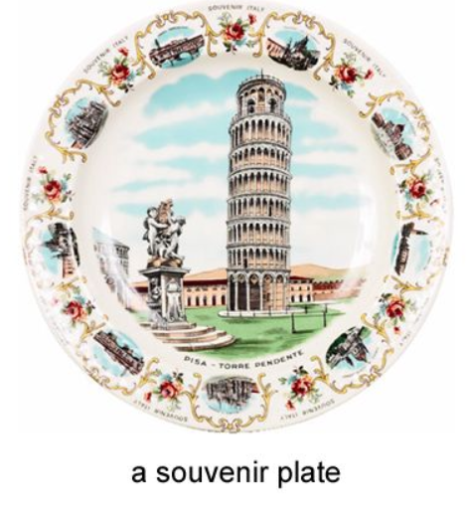
souvenir / ˌsuːvəˈnɪə,ˈsuːvənɪə / noun an object that you buy or keep to remind yourself of a special occasion or a place you have visited SYN memento
- I bought a model of the Eiffel Tower as a souvenir of Paris.
- a souvenir shop

Slide 5
exclusively / ɪkˈskluːsɪvli / adverb only :
- This offer is available exclusively to people who call now.

Slide 6
laundry / ˈlɔːndri / noun clothes, sheets etc that need to be washed or have just been washed :
- She did the laundry (= washed the clothes etc ) and hung it out to dry.
- Ben was folding laundry.

Slide 7
THANK YOU

